Slide 1
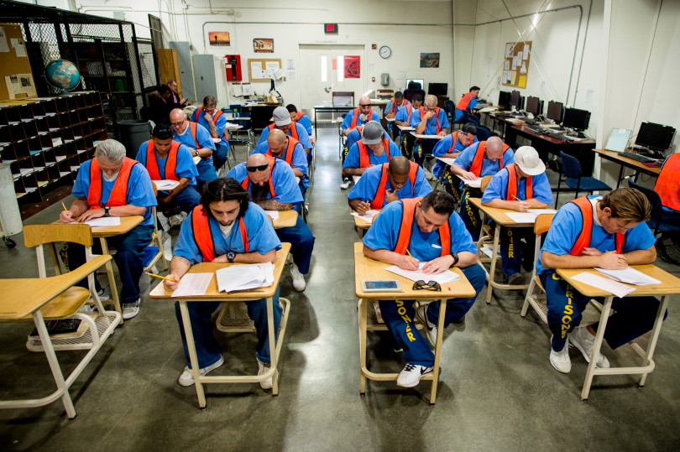
Unlocking Student Potential:
The Norco College Prison Education Program

Slide 2
Prison Education Community
Opportunity: SB-1391, Prop. 57, CRC & CDCR partners
Vision: Pathways to degrees, employment, and reintegration.
Model: Student-centered instruction aligned with Vision for Success and Guided Pathways
Outcomes: Associate Degrees for Transfer in Sociology, Psychology, and Business

Slide 3
Getting Results
2017-18
Pilot Year
120+ students
2018-19
ADT implementation
Day and evening schedules
Off and on-site supports
2019 & Beyond
Graduations & transfer cohorts
Bachelor’s partnership with Claremont Colleges
Robust re-entry program

Slide 4
The Faculty Experience
Unlike other student populations I’ve taught, CRC students are unique in their level of engagement, their drive for success, and their sense of purpose. They [enroll in college] because they understand the transformative potential of higher education, and they are eager to continue after release. They really are amazing students. The energy they have and their excitement are phenomenal. That kind of energy drives academic development and ambition.
- Dr. Lisa Nelson, Professor of English

Slide 5
The Student Experience
From the perspective of an incorrigible, from the inside looking out, I may want to vote for the sheriff one day. Just because I have fulfilled prison-time does not mean I do not think we need laws in our society—we do. We also need district attorneys, mayors, and city managers whose positions in the community are all seated by voters. When the day comes that ex-felons are once again in the midst of free community life, be sure that in some of those individuals beats a heart of gold.
- Conclusion to ENG-1B Essay Titled “Ballot Box Hopeful”

Slide 6
The Student Experience
I am currently living through my adversity, but soon I will excel beyond these walls thanks to you all and others like yourselves that provide a ray of hope for someone like me. I encourage you to continue your assistance to incarcerated students like myself. Even though we can’t see you, we know you are there for us. Thank you and God bless you all.
– Ojore
Most of us are starving for something positive and are thirsty for knowledge. We just need the opportunity. – Lon

Slide 7
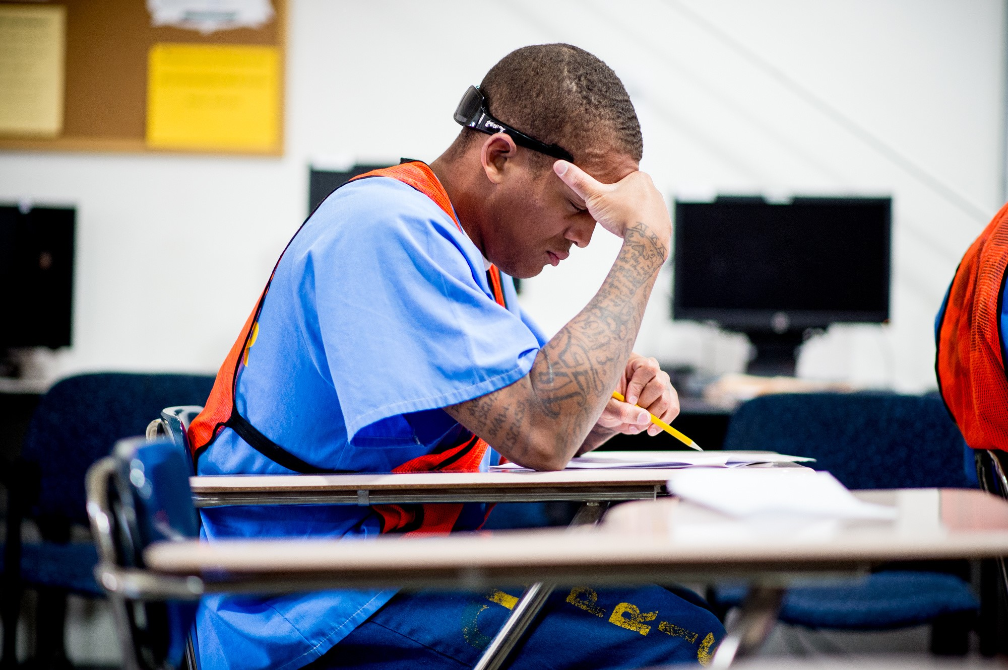
A Worthy Investment
Prison Education:
Eases Overcrowding
Reduces Recidivism
Promotes Rehabilitation
Unlocking Potential
College Infrastructure
Re-Entry Partnerships
Multiple Higher Ed & Career Pathways

Slide 8
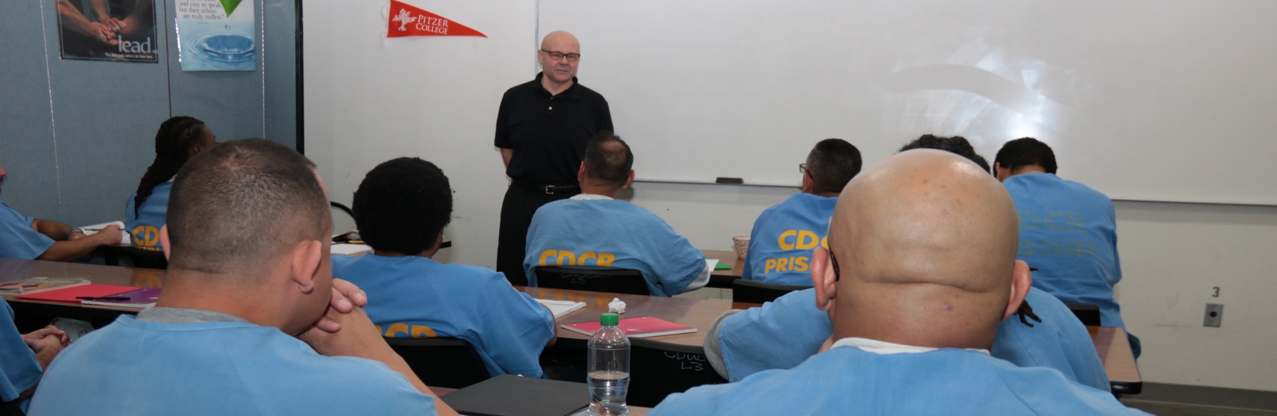
Bryan Reece, President
Jessica Cobb, Director of Prison Education

