Slide 1
What the Evidence Tells Us About the Effectivenes of Correctional Education
Matthew Mizel, PhD, MSW
March 1, 2019

Slide 2
Re-Entry
Each year 700,000 people return from prison
Within 3 years, 40% reincarcerated

Slide 3
In 2013, RAND published meta-analytic results on the effectiveness of correctional education

Slide 4
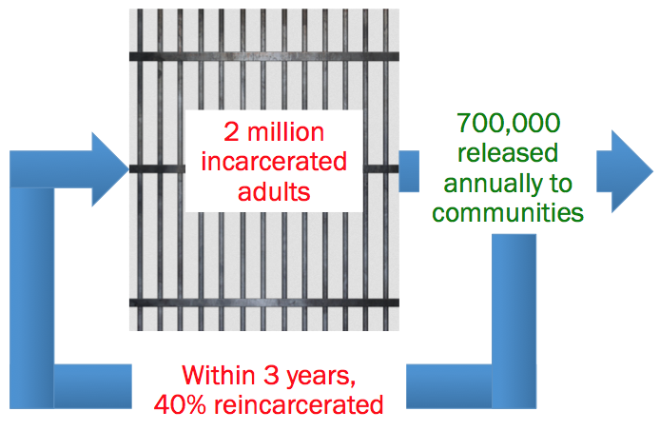
What the meta-analysis showed: recidivism
Those who participate in CE programs vs. those who do not
13 percentage point reduction in probability of recidivating

Slide 5
What the meta-analysis showed: recidivism
Those who participate in CE programs vs. those who do not
In general, ABE, H.S./GED, post-secondary, and vocational education programs all showed reduction in risk of recidivating
13 percentage point reduction in probability of recidivating

Slide 6
What the meta-analysis showed: employment
Those who participate in either vocational/academic CE programs vs. those who do not
13% increase in odds of obtaining employment

Slide 7
What the meta-analysis showed: employment
Those who participate in either vocational/academic CE programs vs. those who do not
But only one study was high quality
13% increase in odds of obtaining employment

Slide 8
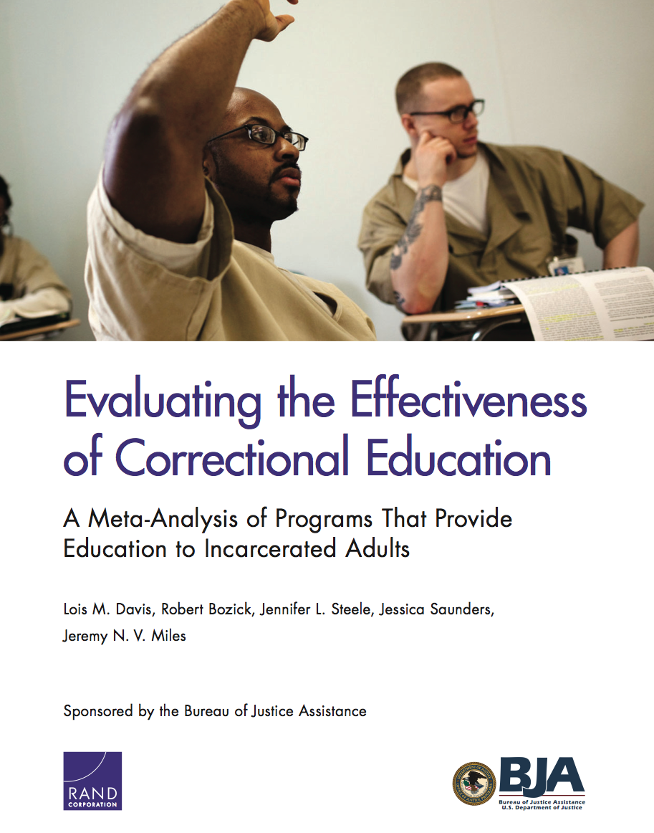
Updated 2018 Meta-Analysis
1st meta-analysis included studies of CE programs from 1980-2011
2nd meta-analysis also included studies of CE programs from 2011-2017
So combined, 37 years of research on CE programs were analyzed

Slide 9
Initial estimates of CE effectiveness still hold
Recidivism: those who participate in CE programs had a 13 percentage point reduction in their risk of recidivating
Results hold for all types of CE programs (adult basic ed., GED, vocational/CTE, college courses)
Employment: those who participate in CE programs had a 12 percent increase in their odds of finding employment

Slide 10
Is correctional education cost-effective?
For hypothetical pool of 100 inmates, 3-year reincarceration rate, and direct costs of CE programs and incarceration itself
13 percentage point reduction in probability of recidivating

Slide 11
Is correctional education cost-effective?
For hypothetical pool of 100 inmates, 3-year reincarceration rate, and direct costs of CE programs and incarceration itself
13 percentage point reduction in probability of recidivating
$3.25 million
$970,000 cost savings
$2.28 million
Don’t Participate in CE
Participate in CE
3-Year Reincarceration Costs

Slide 12
Is correctional education cost-effective?
For hypothetical pool of 100 inmates, 3-year reincarceration rate, and direct costs of CE programs and incarceration itself
13 percentage point reduction in probability of recidivating
$3.25 million
$970,000 cost savings
Every $ spent on CE programs
$2.28 million
Don’t Participate in CE
Participate in CE
5$ in cost savings
3-Year Reincarceration Costs

Slide 13
Is correctional education cost-effective?
For hypothetical pool of 100 inmates, 3-year reincarceration rate, and direct costs of CE programs and incarceration itself
13 percentage point reduction in probability of recidivating
$3.25 million
$970,000 cost savings
Every $ spent on CE programs
$2.28 million
Don’t Participate in CE
Participate in CE
5$ in cost savings
3-Year Reincarceration Costs
And results are likely conservative

Slide 14
RAND also examined reentry experiences of those who participated in postsecondary education
Evaluated the North Carolina Pathways from Prison to Postsecondary Education Project
Two-years prior to release individuals had access to postsecondary education
Two-years post-release were provided assistance to complete their education (and earn degree or credentials)

Slide 15
NC had three communities to which Pathways students could return
Chose communities because Local Reentry Councils already established and better able to provide reentry support
Students had to choose between these three communities; in number of instances, that meant being away from family

Slide 16
Reentry itself can be a very challenging time
Many leave prison with very little resources or family support
Students very anxious about finding employment and felt the pressure to work full-time
Fear of homelessness and family pressure to provide support

Slide 17
Balancing a range of responsibilities contributes to reentry challenges
Balancing Work/School/Other Responsibilities
Students were trying to go to school full-time, work full-time, reunite with family, plus some were dealing with other issues (depression, substance abuse)

Slide 18
Challenges of finding employment
Pathways helped students find jobs in 3 NC communities, but degree of help varied across sites
Asheville placed students in jobs right away; Charlotte and Greenville were less hands-on
Program also able to connect students with counseling, etc.
Some students dropped out because they felt they had to choose work over school and felt the pressure to work full-time

Slide 19
Family Role
Some students very close to families—for those not living near their family, it was a difficult choice
Some families supportive in number of ways
Support student being in program
Helped with clothing, food
Offered a place to stay
Helped with a car

Slide 20
Family Role
But family members may also be in need of support: children, parents, grandparents
Students with children—often not living with them, but student wanted to reunite and provide for them
Meant family was a major factor in decision whether or not to remain in program and complete their education

Slide 21
Program Navigators
Quality and dedication of the Program Navigator varied
In many cases, Navigator was instrumental in facilitating college enrollment and linking students to college support services (e.g., tutoring)
In other cases, Navigator was less hands-on

Slide 22
Probation/Parole Officer
Pathways Program tried to work with community corrections to assign officers who would be supportive of the program
Some POs were very supportive
Officers became key member of students’ support system: treated with respect and genuinely cared

Slide 23
Probation/Parole Officer
But some POs were a hindrance
Not familiar with program or felt their job was to only enforce conditions of probation/parole
Some POs didn’t permit students to go visit their family or have them stay with them
Others were unsympathetic to transportation issues that made it challenging to get to work and school within curfew

Slide 24
Having a trusted person of authority is important
Need to sort through challenges they face with reentry, help problem-solve, and help to stay motivated
For some, Pathways Navigator and/or parole officer played that role
“I didn’t have the supportive cast I thought I had been promised when I got out”
But his family and PO ended up being that

Slide 25
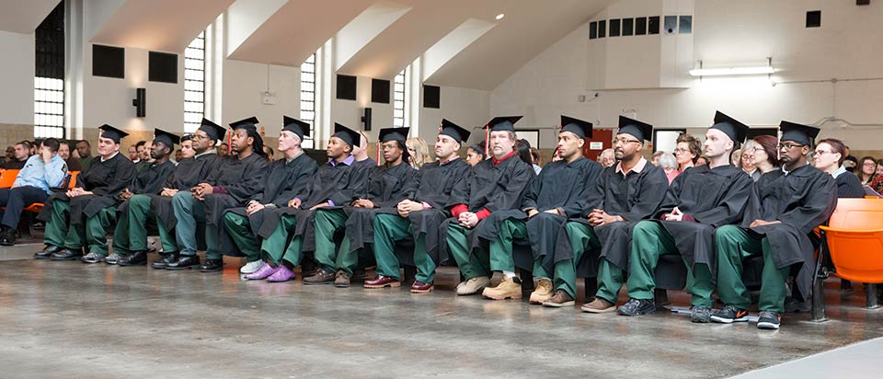
Prison Education
Reduces recidivism
Promotes employment
Need more research on the process
Photo: https://www.rochester.edu/newscenter/rochesters-prison-education-program-aims-to-transform-lives-of-inmates-undergraduates/

Slide 26
Contact Information:
Matthew Mizel (Mmizel@rand.org)
Lois Davis (Lmdavis@rand.org)

