Slide 1
Correctional Rehabilitation?
What
Works

Slide 2
[Parolees] who have obtained a higher education are less likely to recidivate.
(Davis, Bozick, Steele, Saunders, & Miles, 2013)

Slide 3
“In-prison therapeutic community treatment, especially when followed by residential aftercare, was effective for reducing post-release recidivism rates.”
(Nunes, Kevin L.; Firestone, Philip; Wexler, Audrey F; Jensen, Tamara L; Bradford, 2007)

Slide 4
Having a job reduces the odds of re-arrest by 62 percent three months after released from prison.
(Link & Roman, 2017)

Slide 5
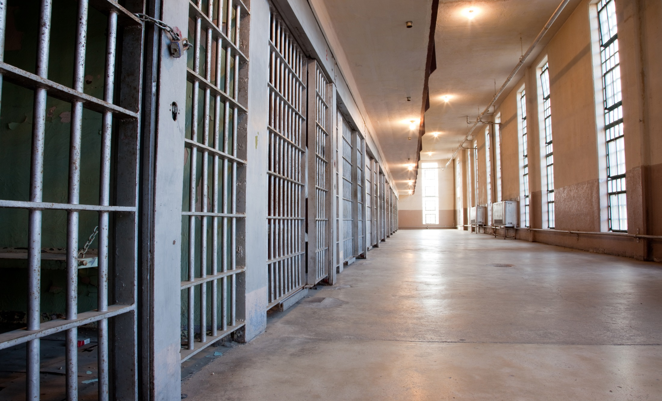
OFFENDER JOURNEY
Begin the rehabilitation process

Slide 6
STEP 1: Assessments
start
The journey begins at intake. Upon entering prison, the offender is given three assessments... the COMPAS, the CSRA, and the TABE.
Assessments

Slide 7
Intake | Three Assessments
Correctional Offender Management Profiling for Alternative Sanctions (COMPAS) COMPAS is a research-based, risk and needs assessment tool for criminal justice practitioners to assist them in the placement, supervision, and case management of offenders in community and secure settings.
COMPAS
These assessments will determine which rehabilitative programs are best suited for offender enrollment.
The California Static Risk Assessment (CSRA) CSRA addresses an offender’s criminogenic needs and assesses their risk to re-offend.
Criminogenic needs are a set of factor(s) that influence an individual’s tendency toward criminal behavior. The greater the criminogenic rating, the more likely an individual is to commit crimes.
CSRA
Test of Adult Basic Education (TABE) - Reading TABE is used to assess the achievement of examinees on core content areas taught and assessed as part of Adult Basic Education programs nationwide. The TABE test is aligned to the national College and Career Readiness Standards for the three core subject areas: Reading, Mathematics, and Language.
TABE

Slide 8
STEP 2: Educational Programs
The offender may be placed in various educational programs, including Academic and Career Technical Education (CTE).
In-Prison Programs

Slide 9
Programs | ACADEMIC
These programs are offered through the Office of Correctional Education (OCE)

Slide 10
Programs | ACADEMIC
Adult Basic Education: ABE is for offenders with reading skills below the ninth grade level. ABE provides opportunities for acquiring academic skills through an emphasis on English Language Arts and Mathematics.
Face-to-Face &
Correspondence College: Face-to-Face college instruction is provided in partnerships with local community colleges to 34 adult institutions; correspondence courses are available at all 35 prisons.
F2F /
CC
ABE
High School Equivalency: GED is for offenders who possess neither a High School Diploma (HSD) nor a High School Equivalency (HSE) certificate. Students receive preparation to take an HSE exam.
High School Diploma: This program provides offenders the opportunity to fulfill current graduation requirements of the State of California, Department of Education, to secure a HSD. Based upon an analysis of the transcript, the student receives instruction in credits needed for graduation.
HSE
HSD

Slide 11
Programs | CTE
CTE training is provided in six different career sectors:
Business
Public Service
Construction
Product Development
Transportation
Utilities

Slide 12
Programs | CTE
CTE Programs include:
Carpentry
Masonry
Plumbing
Industrial Painting
Electrical Construction
Cosmetology
Machine Shop
Heating/Ventilation/ Air-Conditioning/Refrigeration
Sheet Metal
Building Maintenance
Roofing
Welding
Electronics/Network Cabling
Sustainable Landscape Design
Computer and Related Technologies
Auto Mechanics/Engine Service and Repair
Small Engine Repair
Automotive Body Repair and Refinishing
Computer Coding
AutoCAD

Slide 13
STEP 3: Cognitive Behavioral Treatment (CBT) Programs
In-Prison Programs
CBT is an evidence-based treatment approach that teaches offenders how to identify and change destructive thought patterns.

Slide 14
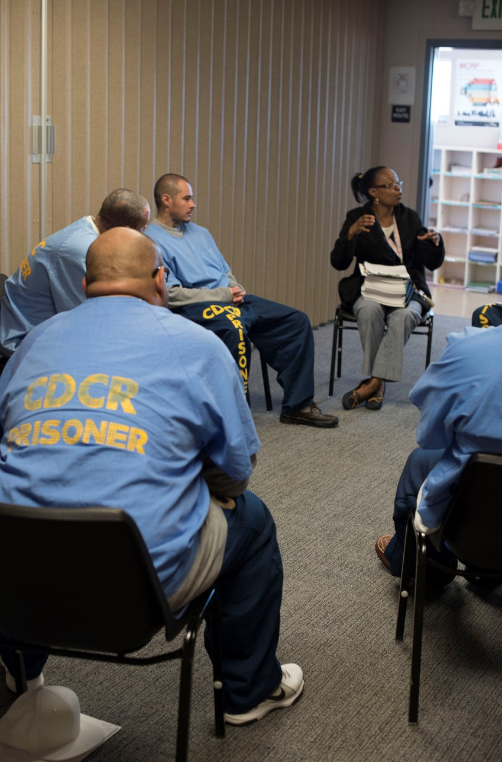
Programs | CBT
Substance Use Disorder Treatment
Family Relationships
Anger Management
Criminal Thinking
Victim Impact
(LTOP)
Denial Management
(LTOP)

Slide 15
STEP 4: Special Programs
Specialized programming is available for eligible offenders or those with long-term sentences.
In-Prison Programs

Slide 16
Programs | SPECIAL
Long Term Offender Program: LTOP is a voluntary CBT program that provides evidence-based programming to offenders who are subject to the Board of Parole Hearings parole suitability process.
Step-Down Program: SDP provides offenders placed in a Security Housing Unit the opportunity to earn enhanced privileges by refraining from participation in Security Threat Group affiliations and behaviors.
LTOP
SDP
Cognitive Behavioral Interventions for Sex Offenders: CBI-SO provides CBT programming to address the criminogenic needs of offenders who are required to register pursuant to Penal Code Section 290 (PC 290).
Offender Mentor Certification Program: OMCP is a voluntary program for long-term and life-term offenders. It provides training and certification to become a Certified Offender Mentor for Alcohol and Other Drug counseling. Graduates are assigned as co-facilitators in Substance Use Disorder Treatment programs throughout all adult institutions.
CBI-SO
OMCP

Slide 17
Additional Programming
Arts-in-Corrections This program, led by professional artists, is designed to reduce recidivism by allowing offenders to express themselves and create self-awareness through the integration of a visual, literary, and performing arts curriculum.
AIC
Innovative Programming Grants These grants were originally funded in the 2013-14 budget and in subsequent years have created and funded programming opportunities at over 190 locations within adult institutions statewide providing over 50,000 additional self-help programming slots in 2017-18.
IPG

Slide 18
STEP 5: Nearing Parole
Offenders begin re-entry planning and acquire the final necessary skills or services needed for release.
In-Prison Programs

Slide 19
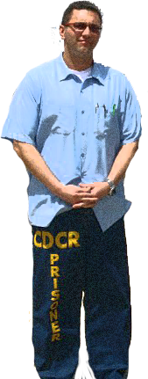
DRP provides various rehabilitative services to offenders during incarceration and while on parole. Rehabilitative programming is the best way for an offender to be prepared for success upon release.

Slide 20
Programs | Nearing Parole
Transitions: This program offers offenders employability, money management, and financial literacy skills to prepare them for a successful reentry into their communities.
Participants learn about community resources and programs that can assist them in their transition back into the community.
CAL-ID Program: The CAL-ID Program streamlines access to support services such as medical, housing, and right-to-work documents.
Male Community Reentry Program: MCRP allows eligible offenders committed to state prison to serve the end of their sentences in the community in lieu of confinement in state prison.

Slide 21
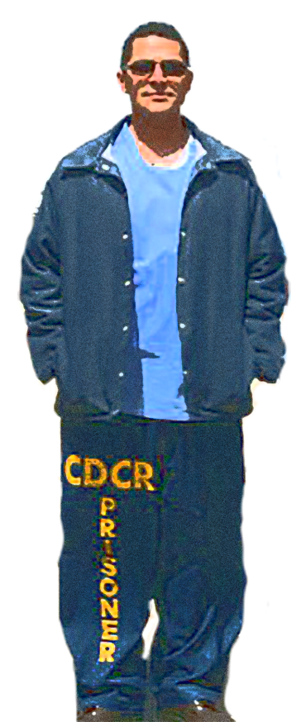
STEP 6: Reentry Assessment
Prior to departing prison, the offender is once again given a COMPAS assessment focused on reentry to determine if they would benefit from additional rehabilitative programs while on parole.
Re-Assessment

Slide 22
BEGIN PAROLE
Parolees now have access to Community Reentry Services

Slide 23
STEP 7: Meet with Parole Agent
The parole agent reviews the COMPAS assessment, and decides which Community Reentry Programs would be beneficial to the parolee.
Community Reentry

Slide 24
STEP 8: Enroll in Parolee Programs
Community Reentry
Parolee enrolls in community reentry programs, which are located throughout the state of California. These volunteer programs are delivered through residential, outpatient, and drop-in centers.

Slide 25
Community Reentry | PROGRAMS
Computer Literacy Learning Center: CLLC provides classroom instruction that focuses on basic proficiency in reading, writing, and math.
Day Reporting Centers: DRC addresses the assessed needs of parolee participants. Services include counseling, education, family reintegration, substance use disorder education, life skills training, and more.
CLLC
DRC
Transitional Housing Program: THP provides residency and support services that focus on long-term offender needs such as employment, job search and placement training, stress management, victim awareness, computer supported literacy, and life skills.
Parolee Service Center: PSC provides residency and support services for parolees that focus on employment, substance use disorder education, stress management, victim awareness, computer supported literacy, and life skills.
THP
PSC
Continued on next page…

Slide 26
Community Reentry | PROGRAMS
Female Offender Treatment and Employment Program: FOTEP provides a smooth transition for female offenders from custody to the community, focusing on intensive, gender-responsive counseling services.
Caltrans Work Crew Program: This program provides transitional employment through litter abatement services for the California Department of Transportation.
FOTEP
CalT
Substance Abuse Treatment and Recovery Program: STAR provides relapse prevention education to parolees with substance use disorder treatment needs.
Specialized Treatment for Optimized Programming: STOP assists parolees during their transition into the community. Includes substance use disorder treatment, detoxification, health education,
life skills, family and group counseling, sober living housing and more.
STAR
STOP

Slide 27
STEP 9: Parole Accomplished
Community Reentry
Parolee successfully rejoins society.

Slide 28
Today’s Offender is Tomorrow’s Neighbor

Slide 29
References
Davis, Bozick, Steele, Saunders, & Miles. “Evaluating the Effectiveness of Correctional Education A Meta-Analysis of Programs That Provide Education to Incarcerated Adults”. Rand Corporation, p. 34.
Link & Roman. “Longitudinal Associations Among Child Support Debt, Employment and Recidivism After Prison.” 58 Soc. Q. 140. 2017.
Nunes, Kevin L; Firestone, Philip; Wexler, Audrey F; Jensen, Tamara L; Bradford, John M. Law and Human Behavior Vol. 31, Iss. 3, (Jun 2007): 305-318.

